Slide 1
Unet with Anaconda
Standard Operating Procedure (SOP)

Slide 2
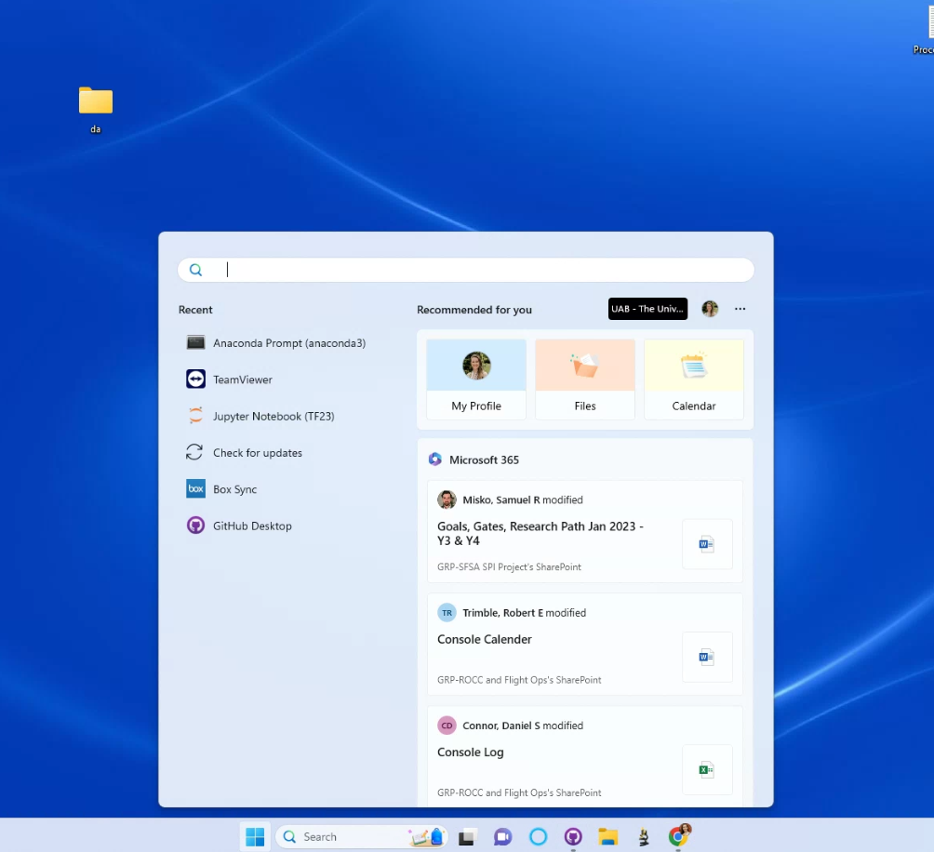
Open anaconda
Click the windows search button on the research computer or device that the GitHub repository has been installed on

Slide 3
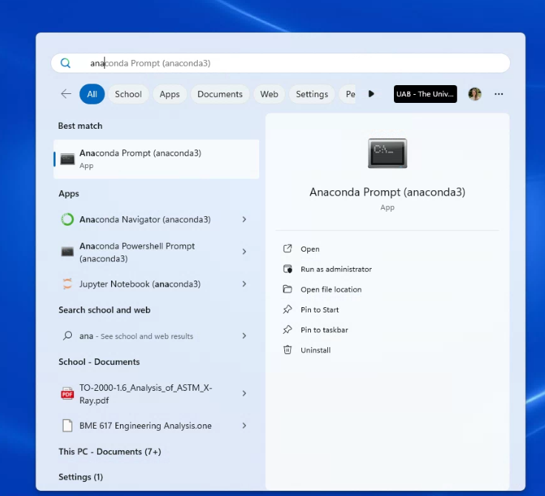
Type in anaconda prompt
You can alternatively use the navigator, but this tutorial will show you how to use the prompt command window to locate and activate the environment and code quicker

Slide 4
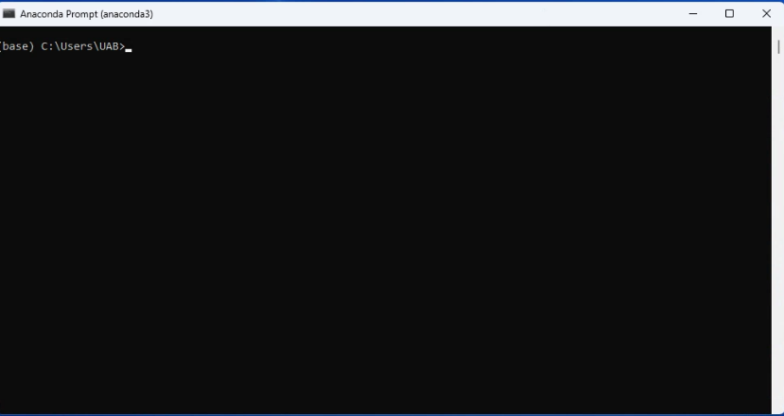
Anaconda command window
This is the command window, there are several ways to navigate and use this
This is opening into the base environment
DO NOT INSTALL OR UPDATE PACKAGES AT THIS STAGE
You must first activate the environment

Slide 5
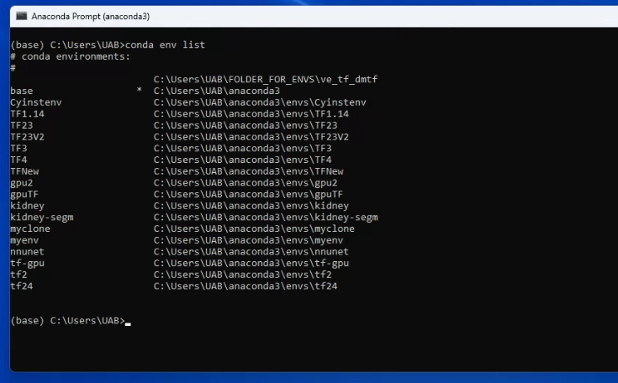
Navigate to the environment
Type in conda env list and hit enter
This will list all the available environments
Each environment houses specific packages and versions that work with each python code

Slide 6
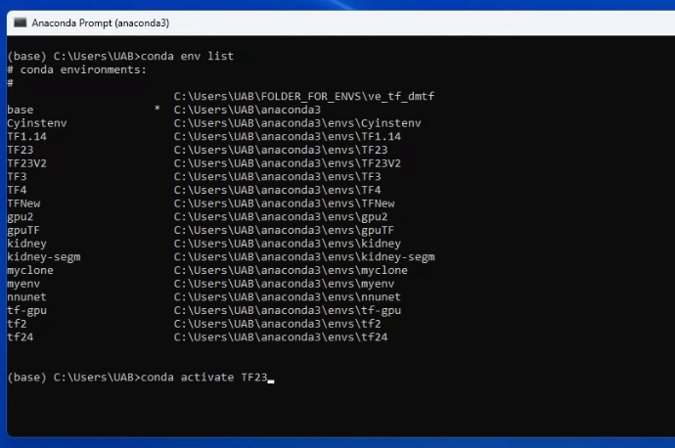
Select Environment
For this code we want to use TF23
Type in conda activate TF23 and hit enter

Slide 7
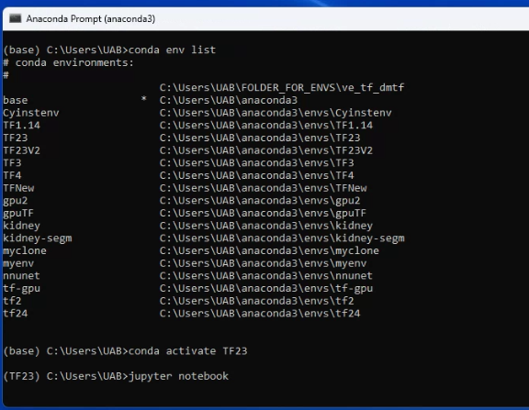
Enter API from environment
Once you have stepped into the environment you can update packages, check versions, and open the API that you want to use
This code uses Jupyter Notebook so to activate type in Jupyter notebook

Slide 8
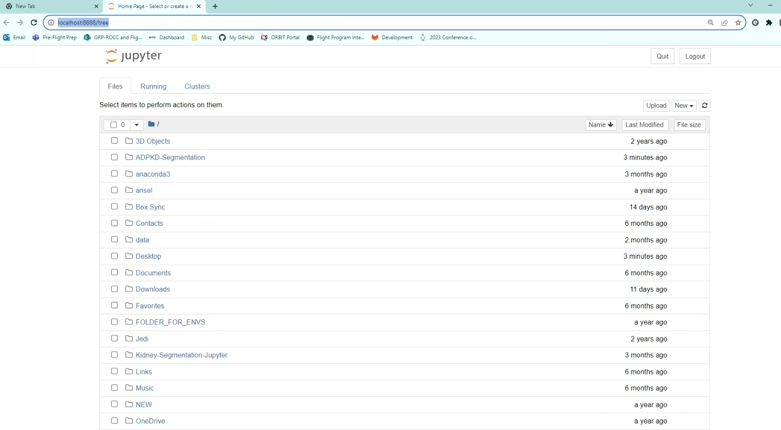
Open Jupyter Notebook
Jupyter notebook should open in chrome or another internet browser on a local host
The kernel will remain active so long as this browser stays open and the anaconda command prompt is open
Navigate to the proper location of the code

Slide 9
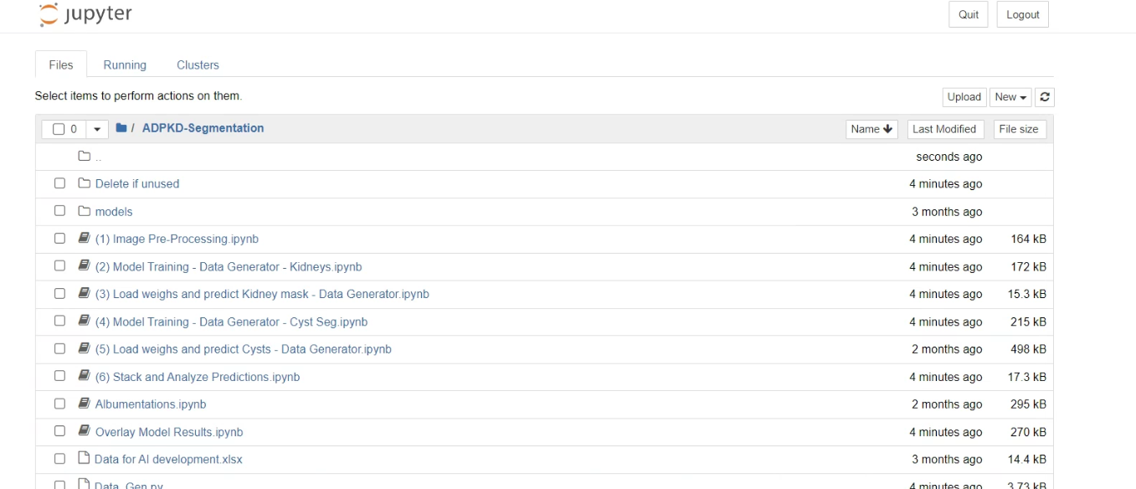
For this code click into the ADPKD-Segmentation folder
Select the step at which you want to start using the code

Slide 10
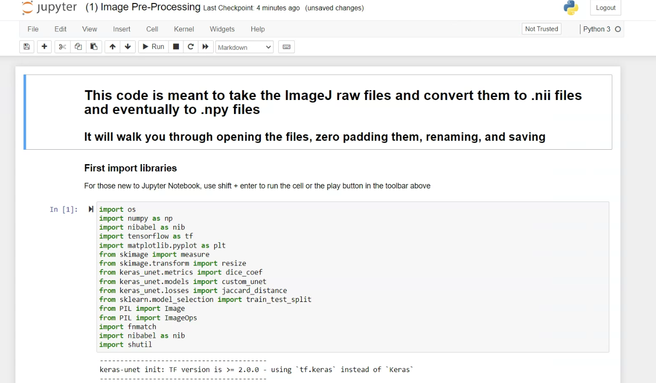
The code will open in a new tab
Make sure autosave is on by clicking trust or that you are manually saving using the save by using ctrl + s or the save button

